Slide 1
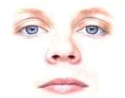
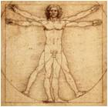

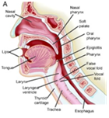
Face
27%
Visual
Body
Non-verbal
65%
19%
Enactor (Encoding) (a)
Recipient (Decoding) (c)
Voice
18%
Audio
Speech
35%
35%
Verbal
Channels (b)

Slide 2
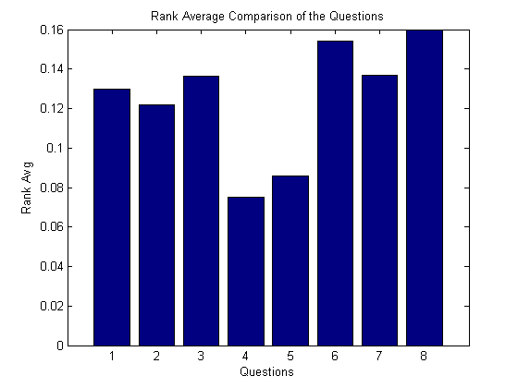

Slide 3
Relative Importance of Visual Social Cues
Relative Importance Points
Personal Body Mannerisms
Body Mannerisms
Appearance Change
Facial Expressions
Appearance
Proxemics
Eye Gaze
Identity

Slide 4
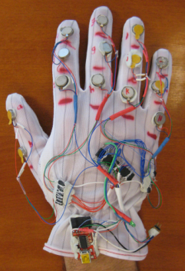
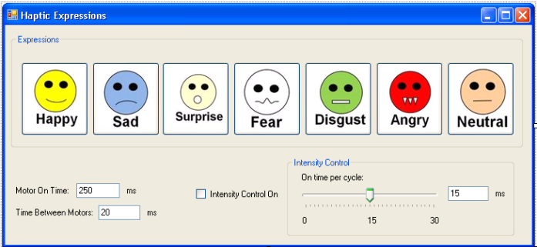


μC
USB to Virtual Serial
Serial port
Motor Driver
Shaftless Vibration Motor
Atmel AtMega168 μC
Darlington Motor Drivers
μC Prog. Port
USB to Serial
Debug LED

Slide 5
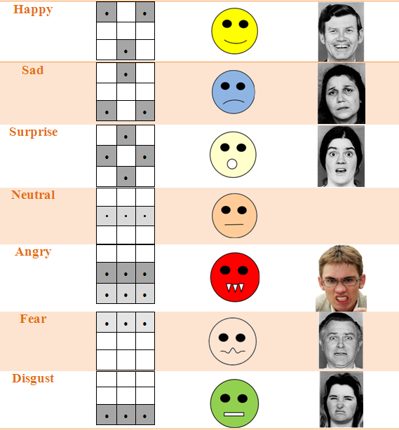

Slide 6
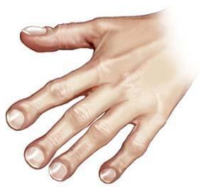
D
G
A
E
H
B
C
F
I

Slide 7
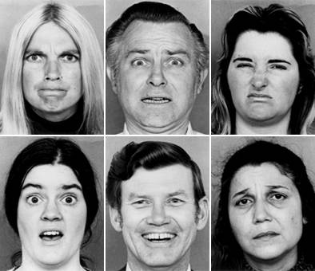

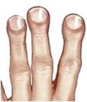


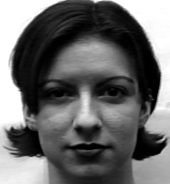





Happy
Sad
Surprise
Neutral
Angry
Fear
Disgust
A
G
A
F
G
F
D
C
D
I
C
I
D
B
H
D
B
F
H
D
F
B
H
B
E
H
E
E
B
C
E
B
H
F
H
I
C
F
I
A
D
G
A
D
G
G
D
A
A
D
G
C
F
I
C
F
I

Slide 8
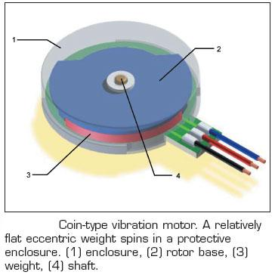
Shaftless Vibration Motor
Atmel ATmega168 μC
Darlington Motor Driver
μC Programming Port
USB-Serial Interface
Debug Port LED

Slide 9
μC
USB to Virtual Serial
Serial port
Motor Driver

Slide 10
Bilateral Interpersonal Communication
Face
27%
Visual
Body
Non-verbal
65%
19%
Enactor (Encoding)
Recipient (Decoding)
Voice
18%
Audio
Speech
35%
35%
Verbal
Channels

